Slide 1
SAR Training Workshops
Committee on Earth Observation Satellites
Report & Lessons Learned
Agenda Item #35
CEOS 6th Working Group for Capacity Building and Data Democracy (WGCapD)-6 Annual Meeting
DLR Oberpfaffenhofen, Germany
27th-29th March, 2017
Phila Sibandze

Slide 2
WGCapD-6 Annual Meeting 2017
DLR Oberpfaffenhofen, Germany 27th-29th March 2017
Presenter Guidance
Note the time allocated for your topic and match the number of slides accordingly.
For the Agency, WG, GEO presentations (Agency numbers 6 – 22):
Summarize 2016 accomplishments
In capacity building for your agency
In capacity building as a contribution to WGCapD
Summarize 2017 accomplishments & plans
In capacity building for your agency
In capacity building as a contribution to WGCapD
Please fill out schedule template also
Summarize 2018-2019 plans (tentative schedules by quarter)
In capacity building for your agency
In capacity building as a contribution to WGCapD
Please fill out schedule template also
Presentation materials should be sent to kim.e.holloway@nasa.gov no later than Monday 20th March for inclusion on the meeting website.

Slide 3
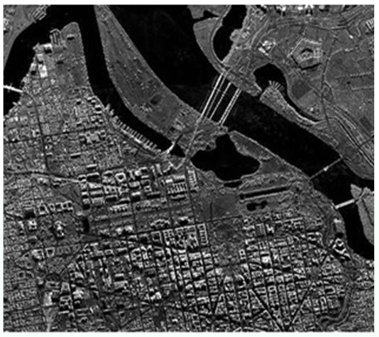
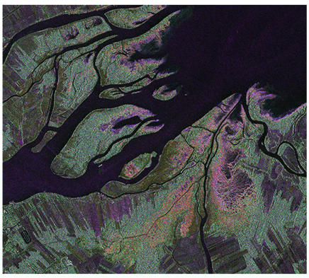
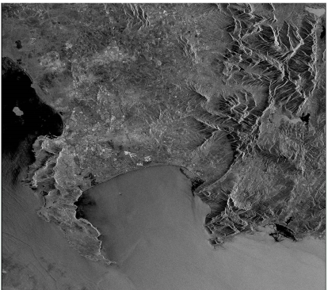
SAR Training Workshops
Lessoned Learned
OBJECTIVE
Bridging the gap between Optical and SAR processing, especially in developing countries.

Slide 4
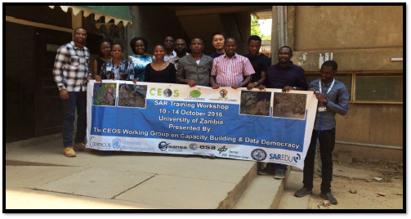
SAR Training Workshops
ZAMBIA
DATE:10 – 14 October 2016
VENUE: University of Zambia
PARTICIPANTS: 12 (33% females)
REGION: Southern Africa

Slide 5
SAR Training Workshops
Lessons learned
BANNER

Slide 6
SAR Training Workshops
Lessons learned
SPONSORS

Slide 7
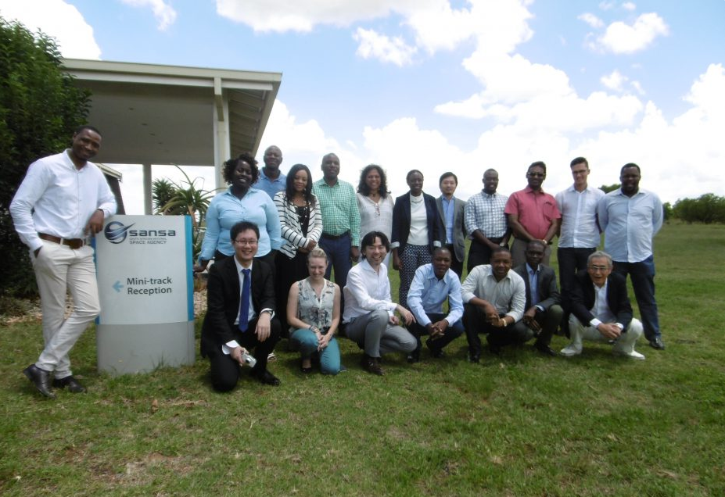
SAR Training Workshops
PRETORIA
DATE:20 – 26 January 2017
VENUE: Pretoria, SANSA
PARTICIPANTS: 13 (23% females)
REGION: Southern Africa

Slide 8
SAR Training Workshops
Lessons learned
SPONSORS

Slide 9
SAR Training Workshops
PRETORIA
DATE:20 – 24 February 2017
VENUE: Libreville, AGEOS
PARTICIPANTS: 23 (26% females)
REGION: Western & Norther Africa

Slide 10
SAR Training Workshops
Lessons learned
BANNER

Slide 11
SAR Training Workshops
Lessons learned
SPONSORS

Slide 12
SAR Training Workshops
Lessoned Learned
Selection Criteria
Revise the criteria to be representative
Time allocation
Increase the time dedicated to hands-on exercises
Funding
Collective responsibility
Local support
Very important to have support from a local partner
Workshop Organisation
Collective responsibility

Slide 13
WGCapD-6 Annual Meeting 2017 DLR Oberpfaffenhofen, Germany 27th-29th March 2017
DLR Lessons learned
DLR contributions
Contract extension to the SAREDU project to support for SAR Training in Africa
SAR Training ZAMBIA: Support with SAR EDU trainer and to organization of program and Trainers
SAR Training GABON: Support to organization of program and trainers from DLR Institutes
Upcoming SAR Training ISRSE: Organization of WS together with SANSA and SAREDU team.
.

Slide 14
WGCapD-6 Annual Meeting 2017 DLR Oberpfaffenhofen, Germany 27th-29th March 2017
DLR Lessons learned
Lessons Learned (1) Engage Trainers…
Support builds on dedicated project funding (SAR EDU) and “in kind” support of DLR trainers
The GABON WS was only possible due to the AFRISAR team support !, good example for combining resources and efforts
A “very small pool” of trainers from ESA, FSU Jena, NASA, and DLR make the workshops possible. Flexible SAR Experts are rare…
For ISRSE WS a much wider support was expected form other Space agencies, still waiting on confirmation of additional trainer from CSA
Challenges:
Consolidate funding resources for trainers
Engage more Space Agencies to actively support
.

Slide 15
WGCapD-6 Annual Meeting 2017 DLR Oberpfaffenhofen, Germany 27th-29th March 2017
DLR Lessons learned
Lessons Learned (2) Organization of workshops and program
Organization of all the two SAR workshops was “just in time” due to several reasons, Thanks to Phila for “excellent fast last mile” efforts.
Agenda planning was based on Requests from local Space Agencies and daily availability and Specific knowledge of Trainers
Worked out better than expected: Thank to flexibility of trainers
Training presentations and exercises.:
Course content varies due to different trainer for same topics,
The exchange and availability of WS presentations and exercises before and after the training needs to be improved.
Challenges:
A midterm planning to support a better and more relaxed organization, taking into account the “best effort” of all engaged partners
Consolidate a flexible Training package program and provision of training material
Clear responsibilities and roles of activities

Slide 16
DLR EO training courses – evaluation summary

Slide 17
WGCapD-6 Annual Meeting 2017 DLR Oberpfaffenhofen, Germany 27th-29th March 2017
Results from SAR EDU Summerschool evalutation 2013-2016
.

Slide 18
SAR EDU Summerschools evaluation
Format:
SAR EDU Summerschools started 2013
5 days training not changed since then
Free of charge for participants
Target audience:
Initially objective was “ train the trainers“ but..
SAREDU was always open to universities, Institutions and companies from beginning
In 2015 a selection process was introduced due to too many applications in 2014
Number of participants 30 - 45

Slide 19
SAR EDU Summerschools evaluation
Agenda:
marginal changes in the first years, application focus vary
Since 2016 applicants were asked about interests
In 2016 the first time parallel sessions were introduced
Since 2015 practical sessons are included (70/30; Theory/Praxis)
Overview and Theory Basics:
Introduction, Maths, Sar Basics (Physics), SAR Processing
Advanced:
InSAR, PolSAR, Time Series
Applications
Ozeanography, Lithosphere, Anthroposphere, Hydrosphere, Biosphere

Slide 20
SAR EDU Summerschools evaluation
Participants liked most:
Professional organization
Mix of theory and exercises
Feasible for beginners..
Diversity of partcipants
Diversity of topics
Competence, enthuasimus and friendliy support of trainers
Social event
Free of charge

Slide 21
SAR EDU Summerschools evaluation
Improvements may be achieved:
BEFORE THE TRAINING
More Information before the workshop
Provide a commented course cataloque
Provide material to prepare for the course
Some state that their pre-knowledge was too low,
DURING THE TRAINING
Better coordination of content between trainers
Increased number of practical application examples
Some applications modules had to much theory
Some require more support by trainers during exercises and/or more supporting information
Feedback to Applicability of aquired knowledge: About half respond neutral or say rather no
Betterr

Slide 22
SAR EDU Summerschools evaluation
Improvements may be achieved:
DURING THE TRAINING
Increased number of practical application examples
Some applications modules had to much theory
Better Focus on which methods are useful for which application
Detailed desription of steps in exercise
Less formula…
Better coordination of content between trainers
Some require more support by trainers during exercises and/or more supporting information
The language issue

Slide 23
SAR EDU Summerschools evaluation
Improvements may be achieved:
AFTER THE TRAINING
Applicability of aquired knowledge: About 50 % respond neutral or say rather no, how to improve..
Give information about follow up training activities and relevant material

Slide 24
ESA EO training courses – evaluation summary CEOS WGCapD SAR workshops in Zambia and Gabon – evaluation summary

Slide 25
Training Course Evaluation Cycle
The customer evaluation process for training courses takes the form of a cycle:
Feedback is obtained from training course participants upon completion
Feedback is analysed and summarised
Subsequent courses are improved, taking into account the evaluation from previous courses
Obtain feedback
Questionnaire
Analyse feedback
Report
Apply lessons
learnt to
Subsequent
training
courses

Slide 26
1) User feedback obtained from participants upon completion of course
Course participants complete feedback questionnaires online at the end of a course. These questionnaires include the following:
Ratings on general aspects of the course: overall evaluation and usefulness with respect to participant’s work/study, quality of lectures and practical sessions, course duration, organisation and facilities, proportion of theory to practical.
Ratings on individual components of the training course, such as particular exercises or theory sessions.
Specific questions, e.g. related to EO data access, whether the participant intends to further use SW & EO data, how the course will be of benefit to the participant
A final open question inviting participants to leave comments and suggestions
Online evaluation questionnaire.

Slide 27
2) Analysis of feedback
The responses from all participants to the questions in the questionnaire are extracted and put into an excel spreadsheet. Analysis is then carried out to determine the general evaluation of participants, and extract key comments and recommendations.
Responses from all participants to each question in the evaluation questionnaire collected into an excel spreadsheet.

Slide 28
3) Production of course report
A report is produced which provides a detailed description of the results of the participant feedback analysis, summarized in charts.
The report begins with a description of the course, including the date, duration, location, host organisation, co-organisers, target audience and course content. The report then provides a detailed analysis of the feedback reporting the common opinion regarding all questions put to the participants. It also lists the most relevant individual comments and recommendations for improvement.
Examples of charts summarising feedback

Slide 29
4) Lessons learned in ESA from recent EO training events
Technological advancements have stimulated a number of changes to the way training events are organised: processing big data is a challenge (difficulty in procuring adequately performing hardware)
Cloud computing and use of virtual machines via internet for training might help. It has the following advantages:
large quantities of data can remain on virtual machines and no need of non-disclosure agreements
students can benefit from the increased processing power of virtual computers (high performance desktops usually not available at the location of the training)
lecturers can connect remotely to these virtual computers prior to the course for testing
In practice however, a number of problems can be encountered with virtual machines: problems with internet connection (good access needed), refresh. This might be a problem in some countries.
For the recent CEOS WGCapD trainings in Zambia (October 2016) and Gabon (February 2017) the inadequate speed of the internet connection in both cases would not have permitted the use of virtual machines.

Slide 30
4) Lessons learned in ESA from recent EO training events
In particular, the availability of Sentinel data brings the need for changes in training:
easier data access freely and directly online from the Sentinels Scientific Data Hub (possibly, in the form of tiles)
enormous increase in the requests for training
more efficient methods of training needed that do not require face to face tuition, including MOOCs (Massive Open Online Courses) and webinars

Slide 31
Quantity of User Feedback
In the period 2009 to the present there were 60 EO educational trainings organised by ESA/EOP-SA (on average 7 per year, but increasing since 2015).
The number of participants per course varies, but a rough estimate is around 30 participants per course.
Training courses are published online and can be accessed via https://earth.esa.int/web/guest/eo-education-and-training
Feedback is completed online, analysed and summarised in a report for each training course.

Slide 32
EO Training Activities organised in 2016
In 2016 the following EO training activities were organized by ESA/EOP-SA. These were delivered to participants at different levels (from secondary school to post-graduate and operational users):
SAR training provided at SELPER symposium in Argentina, November.
CEOS WGCapD SAR training in Zambia, October
SAR training course at university level for members of ECS (European Cooperating States), Latvia, September.
TAT (Trans-Atlantic Training) course on EO delivered in Slovakia, in July.
ESA software training during EARSeL (European Association of Remote Sensing Laboratories) symposium and YSD (Young Sceintist Days) in Germany, June.
EARSeL training on remote sensing for cultural heritage applications, China, June.
SAR training course at university level for members of ECS (European Cooperating States), Bulgaria, May-June.
Demonstration and outreach sessions delivered to the general public and to school classes during the Meteorological and Climate Forum in France, in May.
ESA Living Planet Symposium, School Lab. EO outreach and educational activities to primary and secondary school children. Czech Republic, May.
EO outreach and educational activities to primary and secondary school children during a week of open days at ESA/ESRIN, Italy, March.
ESA Copernicus training, Malta. Training on various applications of Sentinel data to researchers and operational users in Malta. February.

Slide 33
Feedback summary from CEOS WGCapD SAR training in Zambia & Gabon
Language needs to be consistent: all participants should be fluent in the same language, with trainers selected accordingly.
Avoid too much mathematical detail.
MORE TIME FOR PRACTICAL SESSIONS! Software processing always requires much time, patience and repetition. Much more time for practicals has been requested by the large majority of participants!
The actual performances of host computers should be taken into account in advance by teachers (very small datasets need to be used for low performance computers).
Can we afford some follow-up after training, since also requested in the feedback ??

